Slide 1
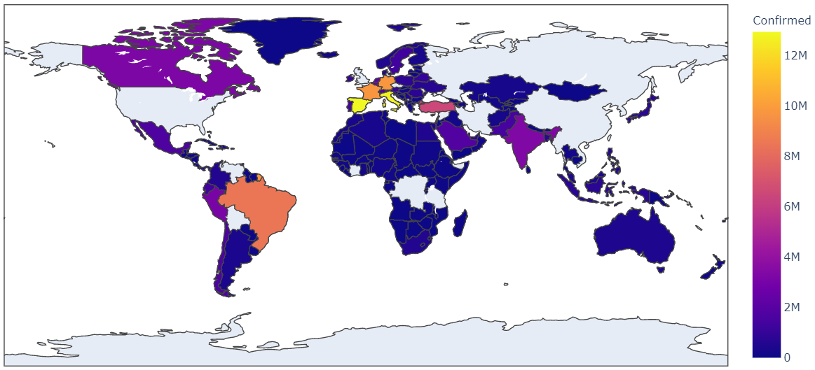
COVID-19 Global Spread
The Novel Coronavirus 2019 dataset, published by Sudalai Rajkumar on the open source platform Kaggle, includes time series data of confirmed tested cases, deaths, and the number of people who have reportedly recovered from COVID-19 worldwide since Jan 22, 2020.
General Observations from the Choropleth map:
1. The cases of COVID-19 starts from China as the epicenter with first initial COVID-19 Cases reported in Australia, US, Canada.
2. Gradually cases in China increases and the confirmed cases is more than anywhere else in the world.
3. Europe emerges later as the new epicenter for the virus, where there is a rapid rise in COVID-19 Cases in European Countries. This outbreak occurs where the confirmed number of COVID-19 Cases in China saturates.
4. The confirmed cases of COVID-19 gradually spreads throughout the world, with spike in confirmed cases seen in European regions and US.
5. As of April 3rd, 2020, USA has the highest number of confirmed COVID-19 Cases reported, with some European Countries emerging as the 2nd-4th highest cases of COVID-19
Data Source: Rajkumar, Sudalai. “Novel Corona Virus 2019 Dataset.” Kaggle, 22 Jan. 2020, www.kaggle.com/sudalairajkumar/novel-corona-virus-2019-dataset.

